Slide 1

FED
WE
E
K
CSS Box Model
Responsive Web Design with Bootstrap
CSS Layout Flexbox
Front End Development
Diploma in CSF
Year 1 (2021/22), Semester 2
4

Slide 2
Remote Learning Instructions
Step 1
Read the given slides
Details in slide 1-15
Step 2
Perform highlighted activities in Activities slide
Details in slide 16
Step 3
Complete and Submit Tasks given
Details in slide 17

Slide 3
Learning Objectives
Understanding the CSS Model in controlling the margin and padding of HTML elements, as well as defining model of a box layout element.
Using Bootstrap Framework to implement responsive web design which optimize web elements display in various device screen sizes.
Using Flexbox to control the flow and alignment of items on web pages

Slide 4
Topics
CSS Box Model
Margin and Padding
Box Border
Responsive Web Design with Bootstrap
Bootstrap Grid System
CSS Flexbox
Setting up Flexbox Container
Controlling Flow in Flexbox Container
Controlling Alignment of Flex Items in Container

Slide 5
CSS Box Model
CSS treats each element on the page using a box model
Styles can specify the margins, borders and padding of the box
E.g. P { margin: 10px; border: 5px solid black; padding: 8px;}
Margin
10px
Border
Margin
5px
Padding
8px
Content
Notes:
Possible Values

Slide 6
Responsive Web Design
Responsive web design makes your web page look good on all devices.
Responsive web design uses 3 core components:
A flexible grid
Responsive sites use methods that allow them to squeeze and flow into the available browser space.
Flexible images
Images and other embedded media need to be able to scale to fit their containing elements.
CSS media queries
Media queries give us a way to deliver sets of rules only to devices that meet certain criteria, such as width and orientation.

Slide 7
Bootstrap Framework
Bootstrap Framework allows creation of responsive layout with much less efforts.
Developed by Mark Otto and Jacob Thornton at Twitter, released in August 2011.
It includes HTML and CSS based design templates for common user interface components like Typography, Forms, Buttons, Tables, Navigations, Dropdowns, Alerts, Tabs, Carousels, etc.
The responsiveness of Bootstrap framework is implemented via CSS flexbox and media queries.

Slide 8
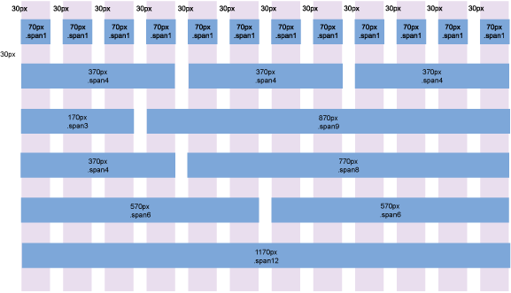
Bootstrap Grid System
Bootstrap's grid system divides a page into 12 equal-width columns. You can group the columns together to create wider columns:
Notes:
Grids in web design organize and structure content, makes the websites easy to scan and reduces the cognitive load on users.
Bootstrap grid system provides the quick and easy way to create responsive website layouts. Bootstrap introduces the responsive mobile first fluid grid system that appropriately scales up to 12 columns as the device or viewport size increases.
Bootstrap is mobile first in the sense that the code for Bootstrap now starts by targeting smaller screens like mobile devices, tablets, and then “expands” components and grids for larger screens such as laptops, desktops.
Mobile First Strategy
Content
- Determine what is most important.
Layout
- Design to smaller widths first.
- Base CSS address mobile device first; media queries* address for tablet, desktops.
Progressive Enhancement
- Add elements as screen size increases.
* Media query is a really fancy term for "conditional CSS rule". It simply applies some CSS, based on certain conditions set forth. If those conditions are met, the style is applied. Media Queries in Bootstrap allow you to move, show and hide content based on the viewport size.
Example:
/* Once the viewport becomes 700px wide or less make all h1 tags 20px. */
@media screen and ( max-width: 700px ) { h1 { font-size: 20px; } }
Reference:
https://www.tutorialspoint.com/bootstrap/bootstrap_grid_system.htm

Slide 9
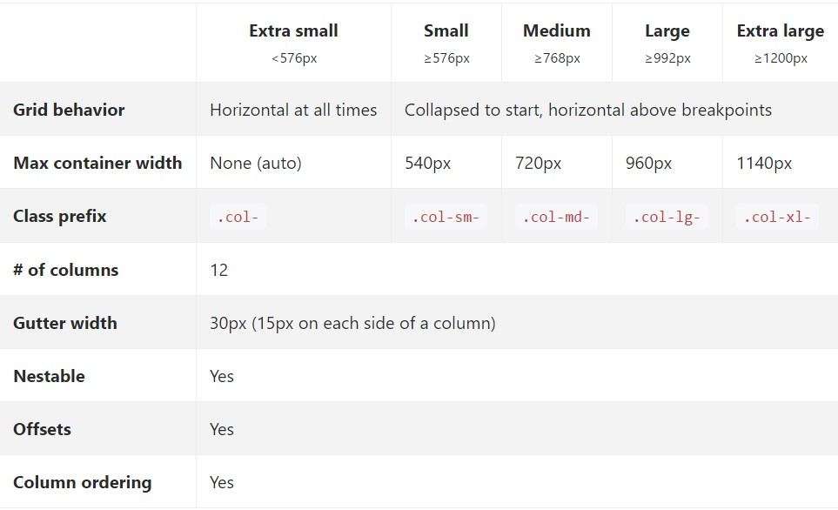
Bootstrap Grid System (cont.)
There are predefined Grid classes for different types of devices:
Bootstrap grid is responsive, and the columns will re-arrange automatically when the screen size is below the breakpoint of the grid class.
Notes:
Responsive Grid
The grid system that we use for one device would not be ideal for another with a different screen size. So, if a page takes up a certain layout for a desktop, it may create a bad user experience in a mobile because it may require the user to zoom in and out or scroll sideways and back, and vice versa. So the ideal case is a website that changes its layout automatically that suits best for the device it is viewed on.
Responsive Breakpoints
Breakpoints are the device viewport width from which point you want your layout to change. These breakpoints are measured in terms of pixels. So if a device's screen size is more than a particular breakpoint the layout of the web page changes to that is most appropriate to give the best user experience.
References:
https://www.w3schools.com/bootstrap4/bootstrap_grid_basic.asp
https://www.bootstrapdash.com/bootstrap-4-tutorial/bootstrap-grid/#responsiveGrid
http://wowslider.com/posts/bootstrap-grid-table-835.html
https://bootstrapcreative.com/bootstrap-4-grid-explained-examples/

Slide 10
Bootstrap Grid Classes
Bootstrap grid system helps to create a responsive layout very easily and quickly with Bootstrap's responsive grid classes:
col- (extra small devices - screen width less than 576px, e.g., portrait mobile)
col-sm- (small devices - screen width equal to or greater than 576px, e.g., landscape mobile)
col-md- (medium devices - screen width equal to or greater than 768px, e.g., portrait tablets)
col-lg- (large devices - screen width equal to or greater than 992px, e.g., landscape tablets)
col-xl- (extra large devices - screen width equal to or greater than 1200px, e.g., laptops, desktops, TVs)
Each class scales up, so if you wish to set the same widths for col-sm and col-md, you only need to specify col-sm

Slide 11
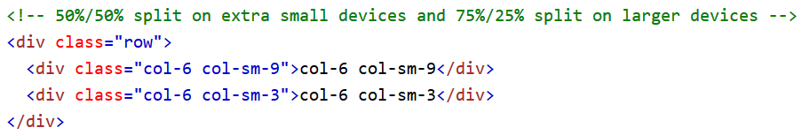
Bootstrap Grid System Rules
Rows must be placed within a .container (fixed-width) or .container-fluid (full-width of screen) for proper alignment and padding
Use rows to create horizontal groups of columns
Content should be placed within columns, and only columns may have immediate children of rows
Grid columns are created by specifying the number of 12 available columns you wish to span, e.g., 3 equal columns would use 3 .col-sm-4
Grid classes can be combined to create more dynamic and flexible layouts, e.g.:

Slide 12
Introduction to Flexbox
Before the Flexbox Layout, there were four layout modes:
Block, for sections in a webpage
Inline, for text
Table, for two-dimensional table data
Positioned, for explicit position of an element
Flexbox Layout makes it easier to design flexible responsive layout structure without using float or positioning.

Slide 13
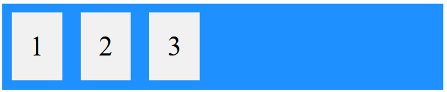
Introduction to Flexbox
A Flexible Layout must have a parent element with the display property set to flex.
Direct child elements(s) of the flexible container automatically becomes flexible items.
Example:
<style> .flex-container { display: flex; background-color: Blue; } .flex-container > div { background-color: #f1f1f1; font-size: 30px; margin: 10px; padding: 20px; } </style> <div class="flex-container"> <div>1</div> <div>2</div> <div>3</div> </div>

Slide 14
Bootstrap Grid
Video on Bootstrap Grid (reference for worksheet)
Tasks | Videos
Using the Bootstrap 4 Grid | https://www.youtube.com/watch?v=qmPmwdshCMw
NB: To make a responsive website, one can use bootstrap. The worksheet has a step-by-step guide to create a responsive website using boostrap.
The video here supplements the worksheet in terms of understanding only.

Slide 15
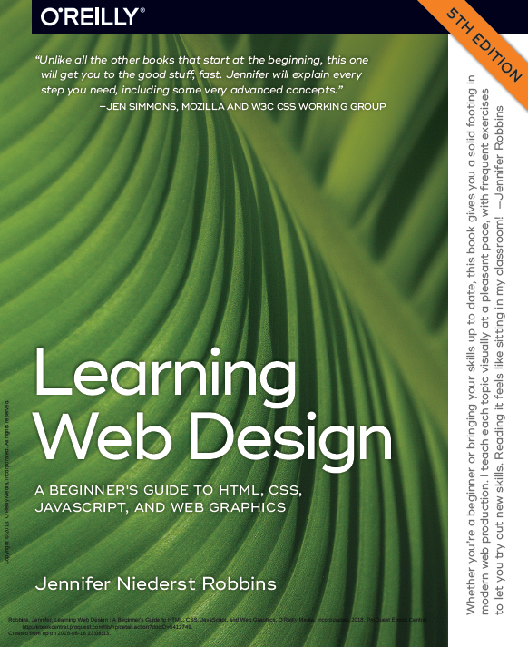
Reference
Learning Web Design
A Beginner’s Guide to HTML, CSS, JavaScript and Web Graphics
Jennifer Niederst Robbins
Chapter 14 to 17
Available to download from NP library:
https://ebookcentral.proquest.com/lib/np/detail.action?docID=5412749&query=Learning+Web+Design
Lynda.com:
CSS Essential Training
Bootstrap 4 Essential Training

Slide 16
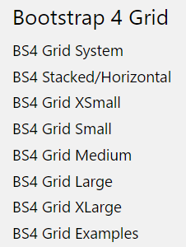
Activities
Read the following chapters from the textbook as reference materials.
Chapter 14 – Thinking Inside the Box
Chapter 15 – Floating and Positioning
Chapter 16 – CSS Layout with Flexbox and Grid
Chapter 17 – Responsive Web Design
Read W3Schools Bootstrap 4 materials. Emphasize on Bootstrap grid. (Optional)
W3Schools Bootstrap 4 Tutorial - https://www.w3schools.com/bootstrap4/default.asp

Slide 17
Tasks
Complete Week 4 Practical.
Download Week 4 Practical in MEL – “FED 2021-10 Week 4 Worksheet.pdf”
Deadline end of Week 4
Submit the completed practical files in MEL.
Zipped the source files
Name the zipped file in following format:-
FED-Week04-SXXXXXXXX (where SXXXXXXXX is your student id)
Submit the zipped file in the weekly folder’s submission link in MEL
Also, submit the zipped file into FED network folder (https:///ictspace.ict.np.edu.sg/FED) under your studentID. This is for backup purpose only. Main submission is still in MEL.
If you have any questions please communicate with your tutor via Microsoft Teams.

Slide 18
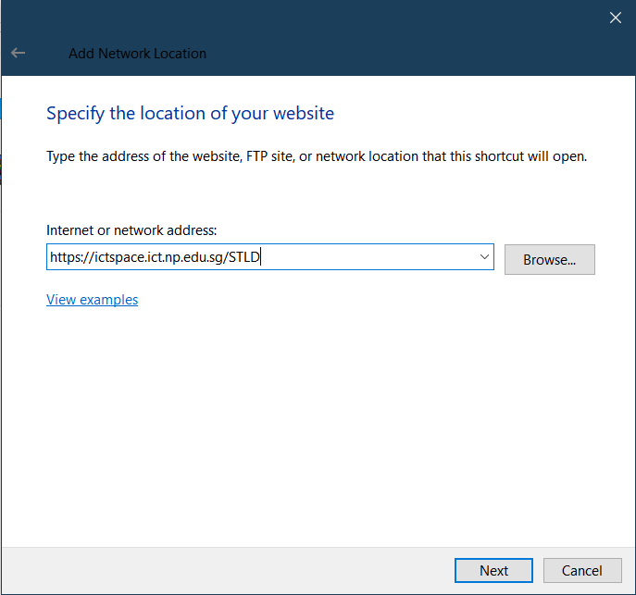
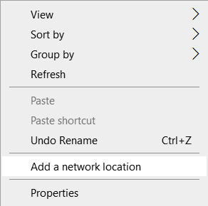
Appendix
Mapped to FED network folder
For Win Users
Right click on a blank space in your Windows Explorer
Select ‘Add a network location’
3. Enter https://ictspace.ict.np.edu.sg/(your assigned module)
4. Press ‘Next’

Slide 19
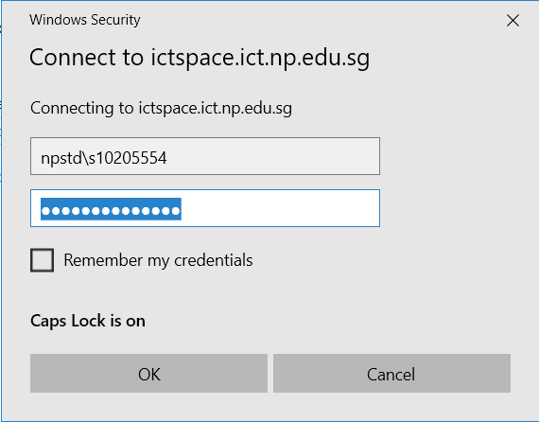
Appendix (Cont)
10123453
4. Login using npstd\s(your student ID number without the last alphabet)
5. Enter your NP student account password

Slide 20
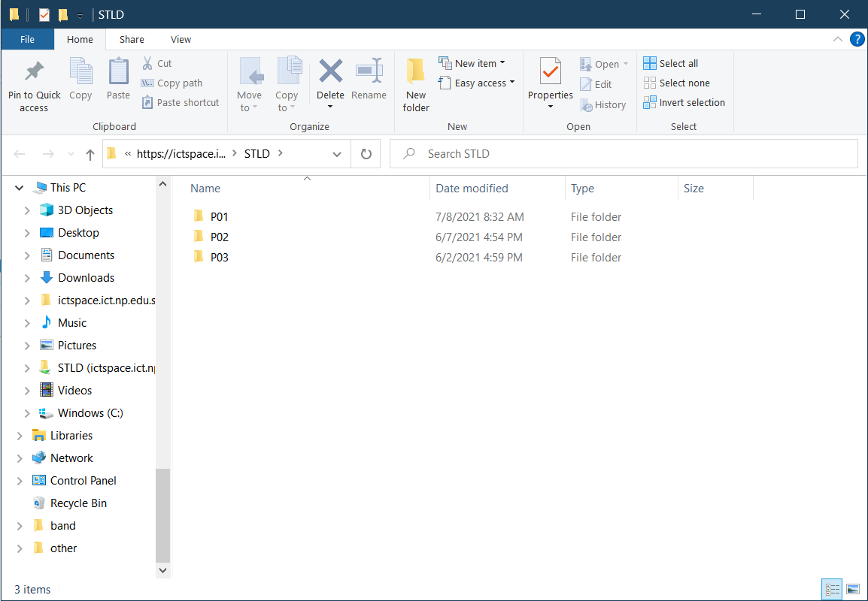
Appendix (Cont)
You should be able to see your class folder as shown in the example below.

